Slide 1


Session 01: Foundation of
Software Engineering
Introduction to Principles, Classification, and Quality
Introduction to Software Engineering | HUFLIT University

Slide 2
PART I: DEFINITIONS
Understanding the Core Concepts

Slide 3


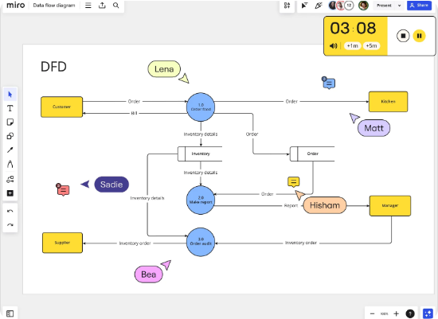
Defining "Software"
More than just code...
Software is defined as a collection of three primary elements:
•
Instructions: Computer programs that provide desired functions and performance.
•
Data Structures: Elements that enable programs to manipulate information effectively.
•
Descriptive Information: Hard copy and virtual documentation describing operation and use.

Slide 4
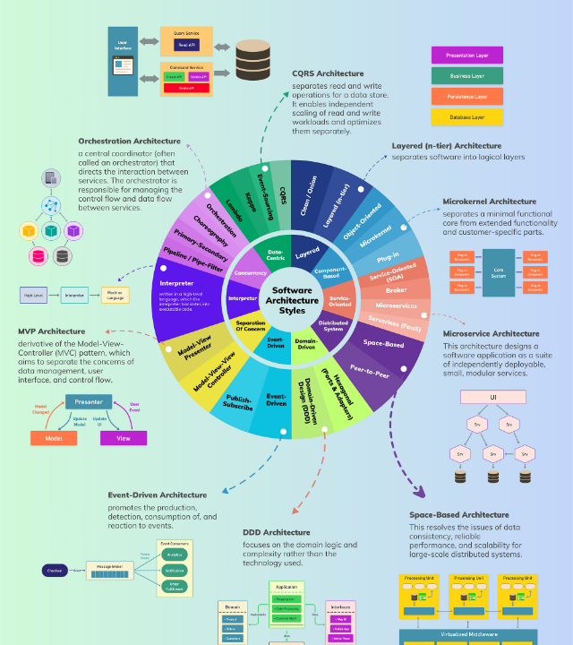
What is Software Engineering?
IEEE Definition: The application of a systematic, disciplined, quantifiable approach to the development, operation, and maintenance of software.
Fritz Bauer: The establishment and use of sound engineering principles to economically obtain software that is reliable and works efficiently on real machines.
It is a layered technology resting on a Quality Focus.

Slide 5
PART II: CLASSIFICATION
Categorizing Software Systems

Slide 6








1. By Application Domain
System Software
Web & Mobile
Embedded
Artificial Intelligence
Manages hardware resources (OS, compilers, drivers).
Network-centric apps for browsers and devices.
Resides within products (control systems, IoT).
Data-driven patterns (ML, Neural Networks).

Slide 7




2. By Development Objective
Generic / Packaged
Bespoke / Custom
Ready-made products sold to a broad audience. Examples: Microsoft Office, Adobe Creative Cloud.
Tailored solutions built for a specific client with unique business logic and requirements.
Framework / Middleware
Open Source
Foundation software used by developers to build other applications. Examples: React, .NET.
Distributed with source code for public modification. Examples: Linux, WordPress, Android.

Slide 8
PART III: QUALITY
Standards and Success Metrics

Slide 9
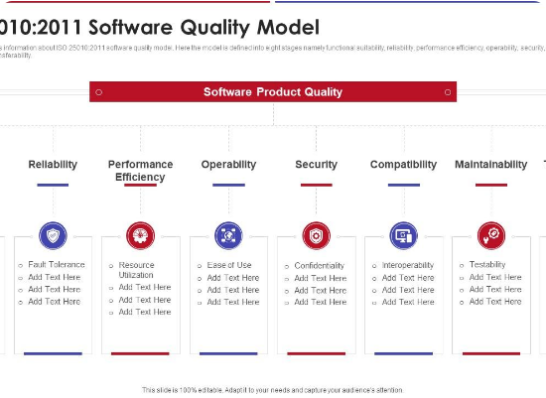
The ISO/IEC 25010 Framework
Defines 8 critical characteristics of software quality:
•
Functional Suitability: Correctness and completeness.
•
Performance Efficiency: Resource usage.
•
Compatibility: Interoperability.
•
Usability: Ease of use.
•
Reliability: Stability under stress.
•
Security: Data protection.
•
Maintainability: Ease of modification.
•
Portability: Multi-environment support.

Slide 10
ISO/IEC 25010 STANDARDS
Characteristic | Definition & Focus
Functional Suitability | Degrees of completeness, correctness, and appropriateness.
Performance Efficiency | Response times and resource utilization under load.
Usability | Ease of use, learnability, and user satisfaction.
Security | Protection of info/data from unauthorized access.
Maintainability | Ease of modifying, updating, or fixing the system.
Reliability | Stability and availability over a specified period.
Compatibility | Interoperability
Portability | Ease of moving across different environments.

Slide 11



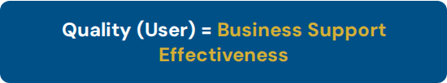
Defining Quality: The User Perspective
Software value is determined by its utility as a business support tool.
Does it handle business tasks quickly and accurately?
Is the data secure and the system safe to operate?
Is it easy to use for all levels of staff?
Can it adapt when our business rules change?

Slide 12












User-Oriented Quality Attributes
Correctness
Evolvability
Usability
Performing all functions precisely as defined by the user requirements and business logic.
The system's capacity to adapt and grow as business requirements and technologies evolve.
The degree of effort required for users to learn, operate, and master the software system.
Efficiency
Security
Safety
Optimal utilization of physical resources like memory, CPU time, and network bandwidth.
Protecting information from unauthorized access while maintaining data integrity.
Operating reliably without endangering the user's environment, resources, or physical safety.

Slide 13
Strategic Priorities for the User
Universal Essentials: Correctness, Evolvability, and Usability are foundational requirements for all software, especially critical for Frameworks and Packaged Software.
Efficiency Targets: High performance is context-dependent; while always desired, it is strictly prioritized in systems with severe resource constraints.
Security & Safety: These attributes are paramount in Contract-based Custom Software, where specific legal and operational liabilities are defined.

Slide 14


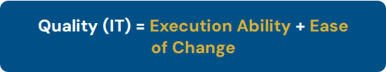
Defining Quality: The IT Professional
For developers and admins, quality is about technical viability and lifecycle cost.
Is it easy to test and identify logical faults?
Can bugs be fixed without breaking other modules?
How simple is it to add new technical requirements?
Can the system be easily migrated to new environments?

Slide 15






Technical Quality Attributes
Implementability
Testability
Maintainability
The ease with which software can be built, coded, and integrated according to its design.
The effort required to establish testing criteria and verify that functions meet their goals.
The ease of modifying the system to correct errors or improve its internal code structure.
Portability
Reusability
Serviceability
The effort required to migrate software from one hardware or software environment to another.
The extent to which software modules can be reused to develop entirely new applications.
The simplicity of performing routine maintenance and system administration tasks.

Slide 16
Strategic Priorities for IT Pros
Universal Foundation: Implementability, Testability, and Maintainability are non-negotiable for all software types to ensure long-term survival.
Support Lifecycle: Serviceability and ease of repair are emphasized heavily in Custom Contract Software to control TCO (Total Cost of Ownership).
Market Scalability: Portability and Reusability are primary drivers for Frameworks and Packaged Software to maximize reach across platforms.

Slide 17
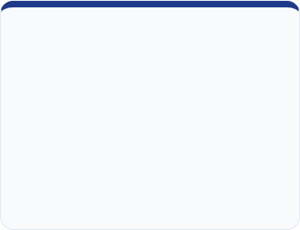
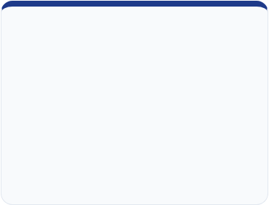
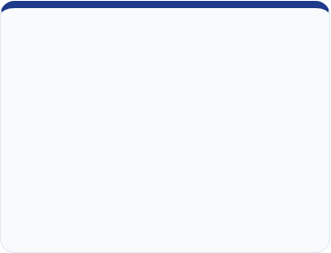



Core Pillars of Excellence
Maintainability
Reliability
Usability
The efficiency with which software can be modified to correct faults or improve performance.
The ability of a system to perform its required functions under stated conditions for a specified period.
A measure of how well specific users can use the product to achieve specific goals effectively.

Slide 18
ECONOMIC REALITY OF SE
60%
The Maintenance Burden
Software costs dominate modern systems. Maintenance alone accounts for 60% to 80% of total lifecycle costs.
of Lifecycle Costs
Effective Software Engineering reduces the "Technical Debt" and long-term costs of upkeep.

Slide 19
Software Engineering Myths
Context | The Myth | The Engineering Reality
Management | "Adding people to a late project speeds it up." | Brooks' Law: Adding resources to a late project makes it later.
Customer | "General objectives are enough to start." | Ambiguous requirements lead to failure and rework.
Practitioner | "My job is done when I ship the code." | Quality depends on maintainability and support.

Slide 20
Software Development Lifecycle
Architecture and Methodology of Modern Software Processes

Slide 21
I. Classification of Process Models
Structural Taxonomy of Engineering Workflows

Slide 22
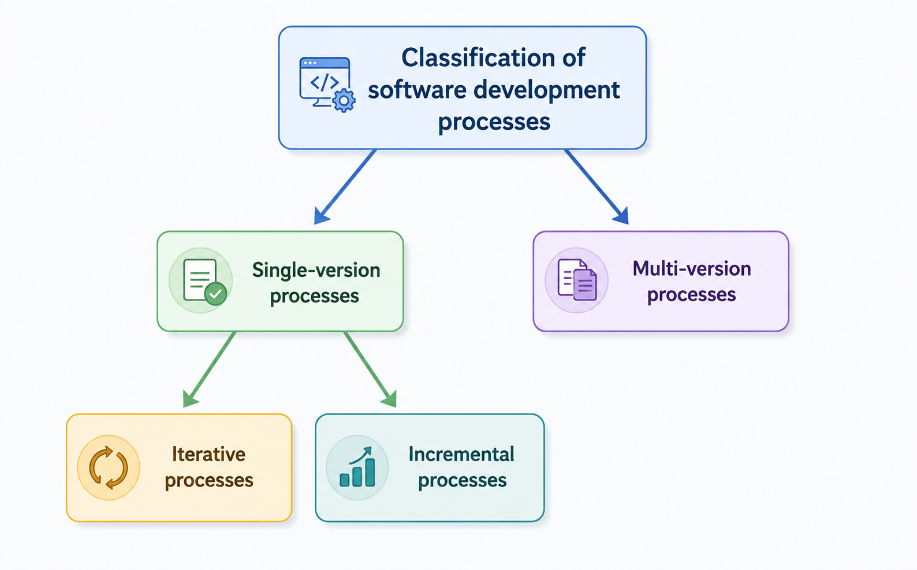
PROCESS MODEL CLASSIFICATION
TAXONOMY OF SDLC

Slide 23


SINGLE-VERSION PROCESSES
Unified Delivery
Designed to deliver a singular, final version of the software system after one cycle.
•
Sequential: Phases are strictly ordered; no overlapping.
•
Iterative: Allows internal cycles to refine specifications or prototypes.
•
Best For: Projects with highly stable and well-understood requirements.

Slide 24
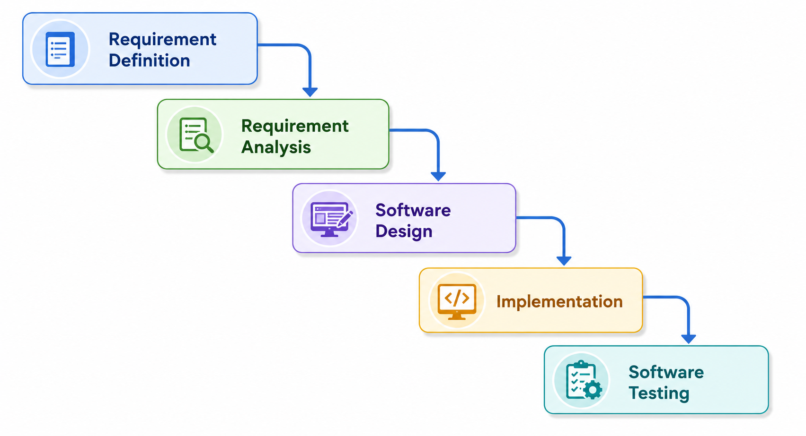
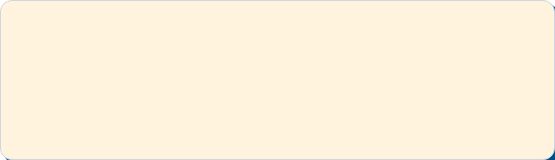
THE STANDARD WATERFALL MODEL
The classical linear model where progress flows strictly from top to bottom.
Limitation: Rigidity makes rework extremely expensive if requirements change late.

Slide 25






ADVANCED WATERFALL MODEL
Feedback Loops: Arrows indicate that each phase can provide feedback to the previous phase for corrections and refinements, making the process more robust and realistic than the standard linear model.
REFINED SEQUENTIAL PROCESS

Slide 26
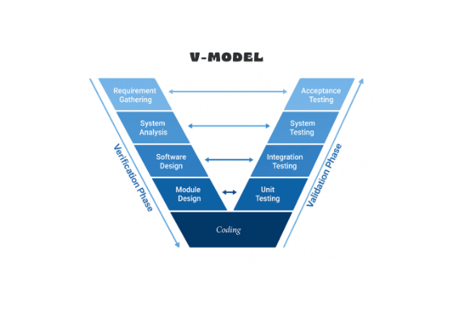
THE V-MODEL FRAMEWORK
Verification & Validation
Extends the waterfall model by mapping development phases directly to testing phases.
•
Verification: Are we building the product right?
•
Validation: Are we building the right product?
•
Benefit: Defects are identified much earlier through proactive test planning.

Slide 27
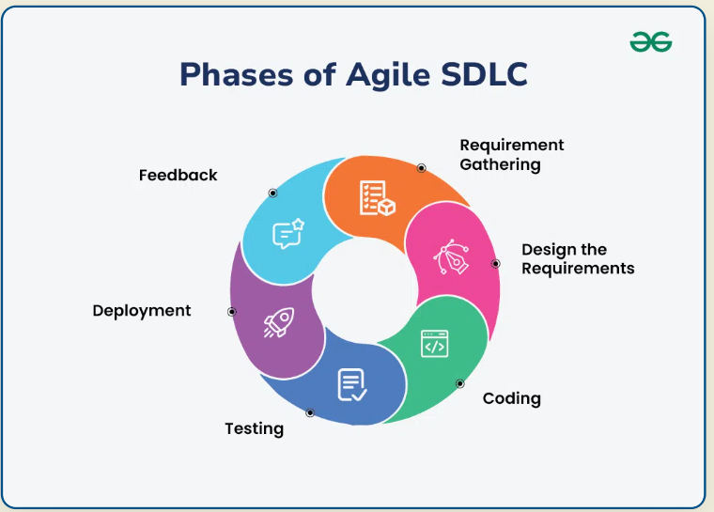
MULTI-VERSION PROCESSES
Evolutionary Delivery
Recognizes that software evolves. Releases are made in increments or versions.
•
Incremental: Each release builds upon the previous, adding new features.
•
Agile: High-frequency releases focused on rapid customer feedback.
•
Benefit: Early ROI and high adaptability to market changes.

Slide 28
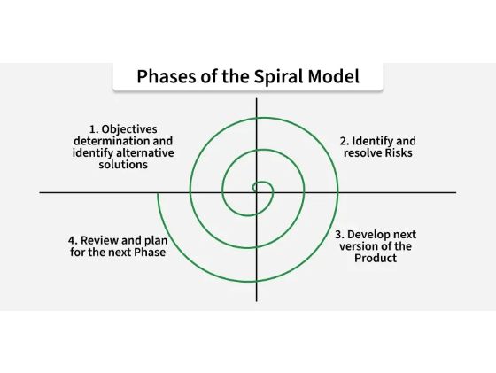
THE SPIRAL MODEL
Risk-Driven Methodology
Combines iterative nature of prototyping with controlled aspects of waterfall.
•
1. Determine objectives & constraints.
•
2. Identify and resolve risks.
•
3. Development and verification.
•
4. Plan the next iteration.
Ideal for large-scale, mission-critical systems.

Slide 29






AGILE METHODOLOGIES
Collaboration
Delivery
Agility
Individuals and interactions over processes and tools.
Working software over comprehensive documentation.
Responding to change over following a rigid plan.
Agile transforms software development into a continuous, iterative journey of value delivery.

Slide 30
COMPARISON OF SDLC MODELS
Criteria | Waterfall | V-Model | Spiral | Agile
Requirements | Static / Clear | Stable / Early | Developing | Evolving
Risk Handling | Low / Reactive | High (Early Test) | Very High (Central) | High (Continuous)
Client Review | Only at end | Late stages | After each cycle | Continuous
Flexibility | Very Low | Low | Medium | Very High

Slide 31

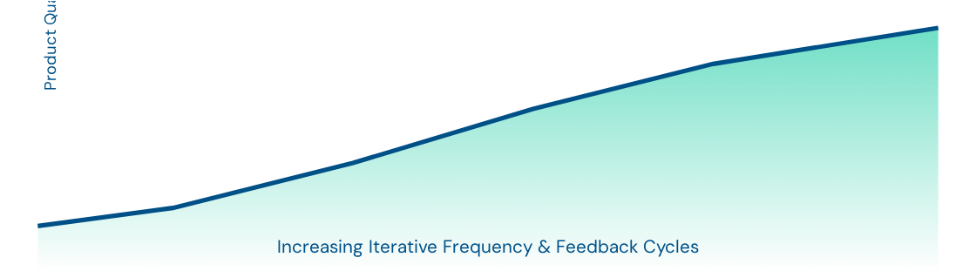
EVOLUTION OF DELIVERY EFFICIENCY
The industry standard has shifted from monolithic, "one-shot" releases to highly iterative feedback loops.

Slide 32
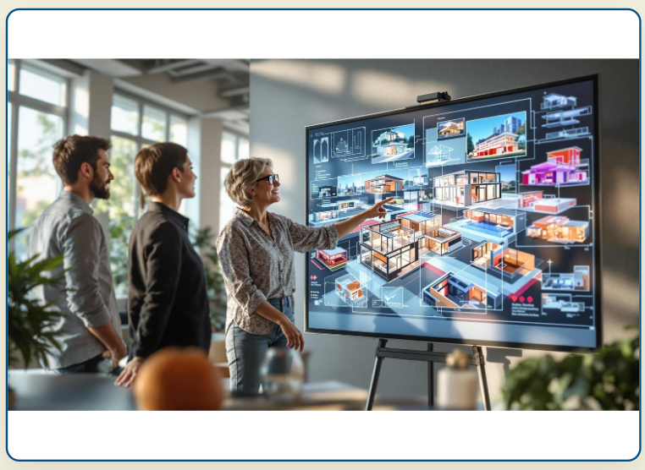
PRACTICAL ENGINEERING
Choosing the Right Model
The selection of an SDLC model is a strategic decision based on:
•
Project size and technical complexity.
•
Requirement stability and clarity.
•
Budgetary and time-to-market constraints.
•
Criticality of the system (Safety, Finance).

Slide 33

— Bill Gates
"Software is a great combination between artistry and engineering."
— Bill Gates

Slide 34
Q & A
Thank you for your attention!
www.huflit.edu.vn | tubtt@huflit.edu.vn

